Slide 1
Java tools (IntelliJ, Maven)
Tapti Palit

Slide 2
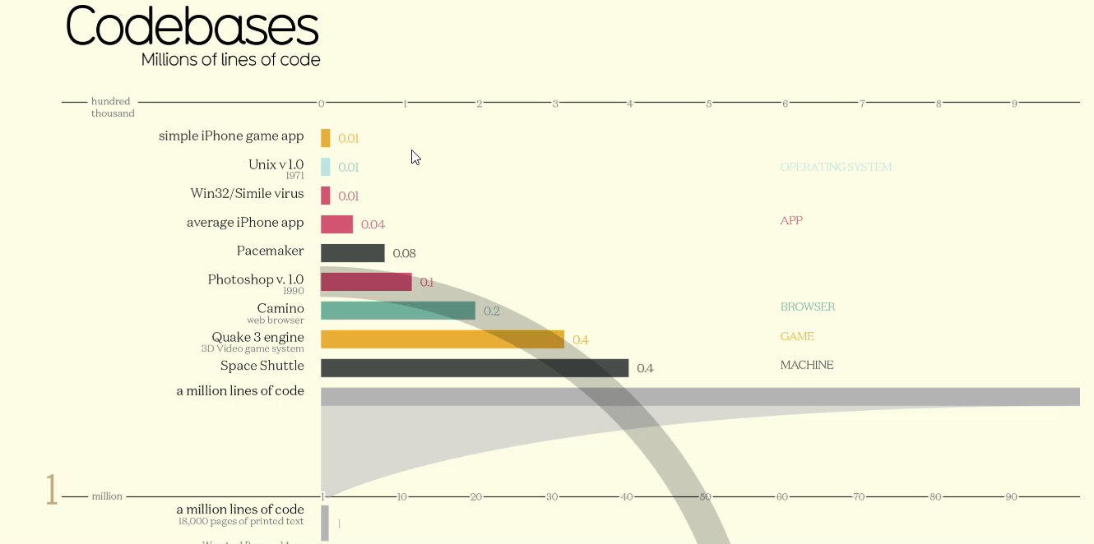
Size and complexity of software
Link: https://informationisbeautiful.net/visualizations/million-lines-of-code/

Slide 3
How to manage complexity?
Hard to remember exact class and method names
Need smart code completion
Need to know which code affected on renaming a class or method
Need code refactoring support
Often use external tools for version control, debugging, performance analysis, and so on
Need an Integrated Development Environment (IDE)

Slide 4


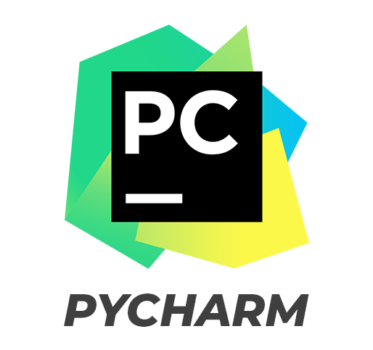


Popular IDEs

Slide 5
IntelliJ Demo
We will use IntelliJ for our assignments
Demo:
Creating new project
Version control using Git
Running and debugging project
Refactoring
Plugins using Marketplace

Slide 6
Java compilation process
Java source file is compiled using javac into bytecode (.class)
Java bytecode (.class) is loaded into the interpreter which starts execution
During interpretation parts of bytecode compiled using Just-in-time compilation (JIT)
MyClass.java
javac compiler
Compile time
MyClass.class
Runtime
java interpreter
JIT compiler

Slide 7
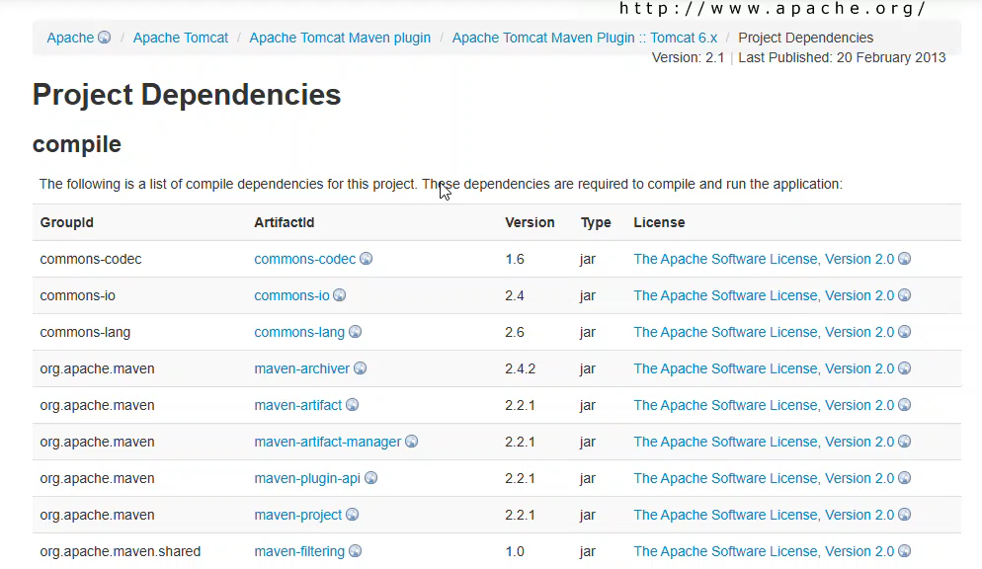
External library dependencies
https://tomcat.apache.org/maven-plugin-2.1/tomcat6-maven-plugin/dependencies.html

Slide 8
How to manage third-party library dependencies?
Libraries (and applications) are packaged as JAR (Java archive) files
A JAR archive consists of multiple .class files
javac YourClass.java
Create a text file named MANIFEST.MF
Manifest-Version: 1.0 Main-Class: YourClass
Use the jar command
jar cvfm YourApp.jar MANIFEST.MF *.class
Run the JAR file
java -jar YourApp.jar

Slide 9
How to manage third-party library dependencies?
Add java .jar files to classpath
javac -cp .:path/to/your.jar YourProgram.java
java -cp .:path/to/your.jar YourProgram
Maven
XML based tool
Gradle
Kotlin/Groovy based tool

Slide 10
Maven
Maven’s goal: make the build process easy and uniform
Dependency management
Build management

Slide 11
Maven dependency management
Maven provides a centralized repository where developers can host project dependencies
https://repo.maven.apache.org/maven2/
These dependencies can be downloaded by any other project
Maven also provides a tool to download dependencies from the centralized repository

Slide 12
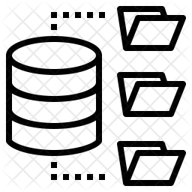

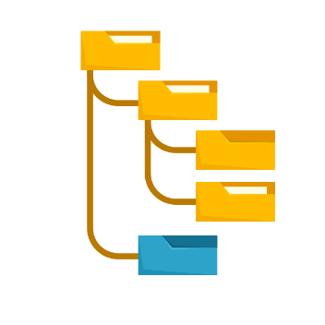
Maven workflow
pom.xml specifies the dependencies
mvn is a command-line tool that can fetch and update all dependencies
fetch
https://repo.maven.apache.org/maven2/
pom.xml
>mvn clean install

Slide 13
Maven build phases
Maven build process is divided into phases
Each phase has goals which correspond to individual commands such as jar cvf … and so on.
Key phases
validate: Validate the project structure
compile: Compile the source code
test: Run unit tests
package: Package the compiled code (e.g., JAR/WAR)
install: Install the package into the local repository
deploy: Deploy the package to a remote repository

Slide 14
Maven goals
Even though a build phase is responsible for a specific step in the build lifecycle, the manner in which it carries out those responsibilities may vary
Can declare goals bound to these phases
A goal is finer than a phase
mvn clean dependency:copy-dependencies package

Slide 15
Extending Maven with plugins
Plugins add goals to your project
Plugins are also centrally hosted in the Maven repo

Slide 16
Sample pom.xml
Demo
<?xml version="1.0" encoding="UTF-8"?>
<project xmlns="http://maven.apache.org/POM/4.0.0"
xmlns:xsi="http://www.w3.org/2001/XMLSchema-instance"
xsi:schemaLocation="http://maven.apache.org/POM/4.0.0 http://maven.apache.org/xsd/maven-4.0.0.xsd">
<modelVersion>4.0.0</modelVersion>
<groupId>com.ecs160</groupId>
<artifactId>annotations</artifactId>
<version>1.0-SNAPSHOT</version>
<dependencies>
<!-- Jedis Dependency -->
<dependency>
<groupId>redis.clients</groupId>
<artifactId>jedis</artifactId>
<version>4.3.1</version> <!-- Use the latest version -->
</dependency>
<dependency>
<groupId>com.google.code.gson</groupId>
<artifactId>gson</artifactId>
<version>2.10.1</version>
</dependency>
</dependencies>
</project>

